Slide 1


Evaluating Effect of Structural Changes in the Vehicle on the Safety of Rear Seat Occupants in Frontal Crashes
Elham Sahraei, Dhafer Marzougui,
Kennerly Digges, Steve Kan
National Crash Analysis Center (NCAC)
The George Washington University

Slide 2
Outline
Introduction
Crash test data
Finite element model
Results
  Effect of weight and stiffness
Discussion and future work

Slide 3
Background
Rear seat occupants accounted for 13% of vehicle travelers during the years of 2000 to 2006
Rear seat occupants also consisted of about 10% of fatalities reported in FARS
Vehicle occupants were historically considered safer in the rear seats [3-5]
Recent studies shown that protection of rear seat occupants have significantly decreased in newer MYs

Slide 4
Vehicle Design Changes
Vehicle designs and characteristics are consistently changing due to different regulations, consumer rating systems, cost-benefit analyses, and engineering developments.
Incorporating High Strength Steels, adding structural members, and increasing sheet metal thickness in the frontal component of the vehicle have the benefit of reducing intrusion into the occupant compartment in case of a crash.
Consequently intrusion-related injuries to the front seat occupants are reduced.
These changes are also useful in reducing the frontal length and weight of the vehicle.
However, these modifications lead to an increase in the vehicle front-end stiffness.

Slide 5
Effects on Occupant Safety
An increase in front-end stiffness of vehicles would be accompanied by an increase in crash pulse transmitted to the occupant compartment in case of a frontal crash.
The way to protect occupants against a more severe crash pulse can be achieved by improvement in restraint system designs, i.e. airbags and seatbelts.
Improvements in restraint system design have been made for front seat occupants through advanced airbags, and by implementing load limiting and pre-tensioning belts.

Slide 6
Rear Seat Safety
However, for the rear seat occupants, not many improvements have been made in the design of restraint systems.
Therefore, the negative effects of these structural changes on the protection of rear seat occupants are not mitigated.
The goal of this research is to evaluate the effects of these structural changes on the protection of rear seat passengers.

Slide 7
Crash Test Data
Full frontal vehicle to barrier crash tests from the NHTSA vehicle database were investigated.
The test types included: New Car Assessment and FMVSS 208 occupant crash protection tests.
In all tests, the impact angle was zero degrees and the offset was zero % (full-frontal). The vehicle types included: passenger cars, pickups, utility vehicles, vans and minivans.

Slide 8
Stiffness Calculations
The static stiffness of the vehicles were calculated by equating the initial kinetic energy to the total potential energy (1/2 mv2 =1/2 Kx2).
Tests, where the maximum crush was equal to zero (8 tests) or less than 100 mm (3 tests), were excluded since the static stiffness could not be calculated.
A total of 1187 tests considered in this analysis. The data was used to assess the extent of change in mass and stiffness of the vehicles over model years 1982 to 2010.

Slide 9
Finite element model-1
The Ford Taurus FE model (version V3C)
The vehicle initial speed was set to 56 km/hr and a fixed rigid barrier model was used to simulate a full frontal NCAP test.
The model was validated against NHTSA Test 5143 which had two 5 percentile female Hybrid III dummies in the front seats and one 5 percentile female Hybrid III dummy in the rear seat

Slide 10
Finite element model-2
The rear seat dummy was modeled using a MADYMO facet model of a 5 percentile female Hybrid III dummy
The dummy model was placed on top of the rear seat cushion and then a settling simulation which applied only gravity to the model was run for 400 ms to make sure the dummy was positioned correctly in the rear seat
The 3 point belt model mesh was developed in MADYMO to make sure the proper contact surfaces were considered for belt routing. The belt mesh was then transferred to LS-DYNA.

Slide 11
Finite element model-3
The slipring, D-ring, and retractor were added to the belt model using the LS DYNA seatbelt elements.
The seatbelt fabric model represents properties of an Automotive Occupant Restrains Council (AORC ) belt model provided by LSTC.
The seatbelt sensor locking acceleration was set to be 0.7 g following the FMVSS 209 Standard. The retractor lock regime curve was extracted from the literature.

Slide 12
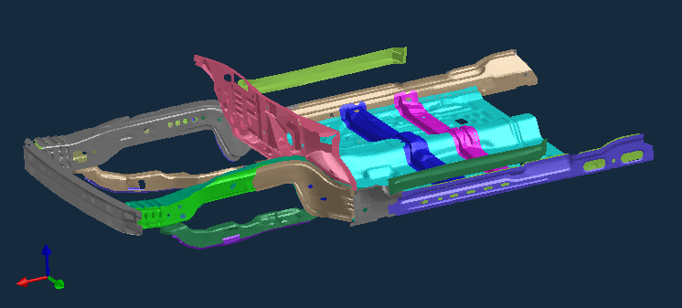
Finite element model-4
To evaluate effect of increase in mass, two additional models were run with an increase of 10 and 20 percent in mass of the vehicle.
To evaluate the effect of increase in stiffness of the vehicle, the yield strength of 29 parts in the model, were increased by about 40% in one model and 80% in the second model.
In a sixth simulation, the thicknesses of the parts shown were increased by 80%

Slide 13
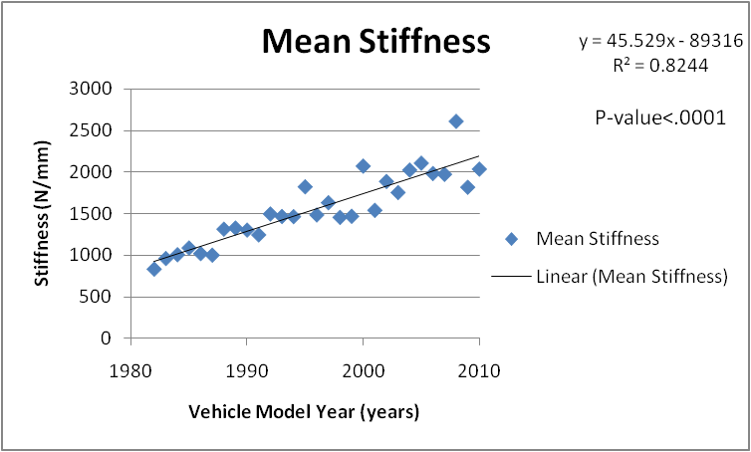
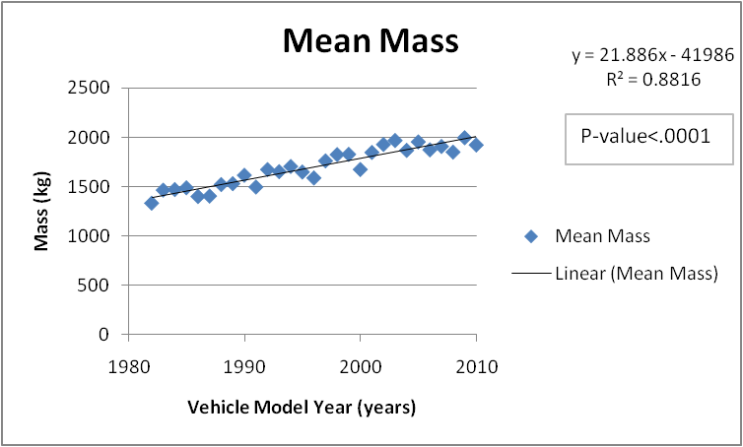
Crash Test Analysis Results

Slide 14
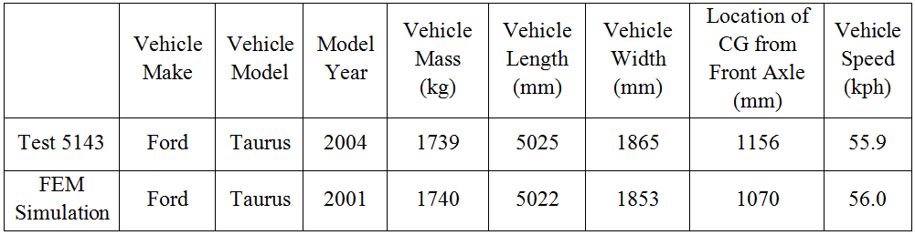
Vehicle Parameters, FE vs. Test

Slide 15
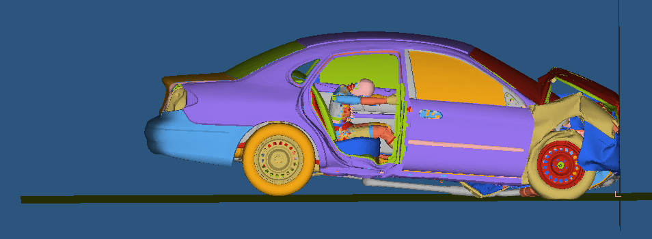
Simulation Result

Slide 16
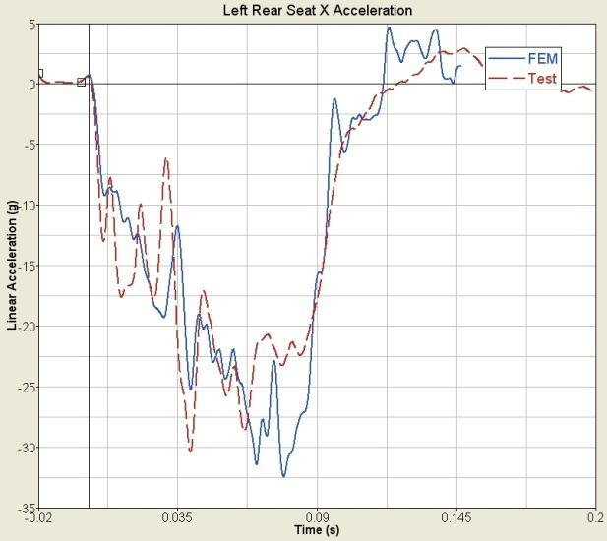
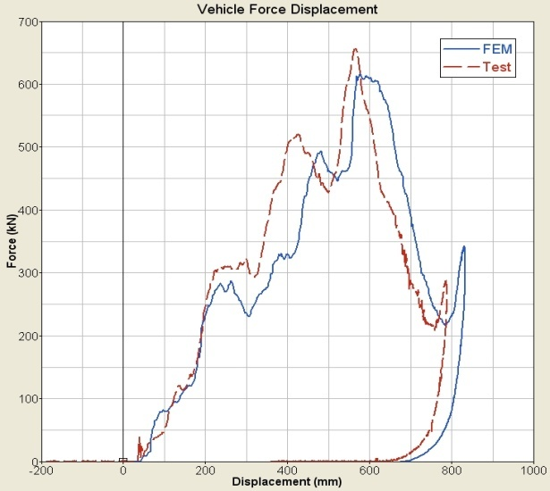
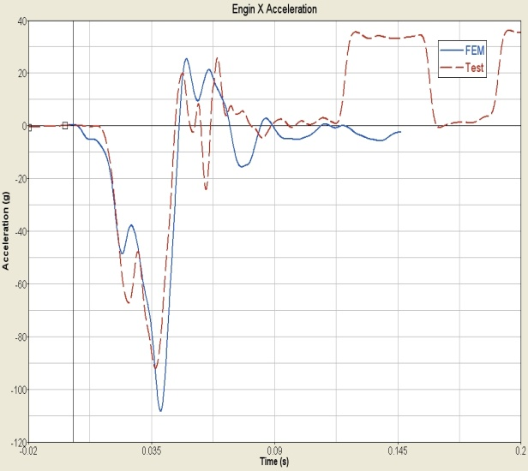
Comparison of Vehicle Acceleration Pulses
Left Rear Seat Acceleration
Top Engine Acceleration
Force- Displacement curve

Slide 17
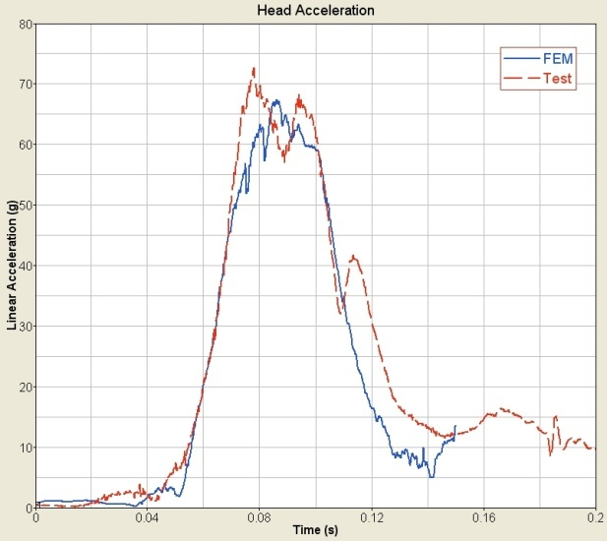
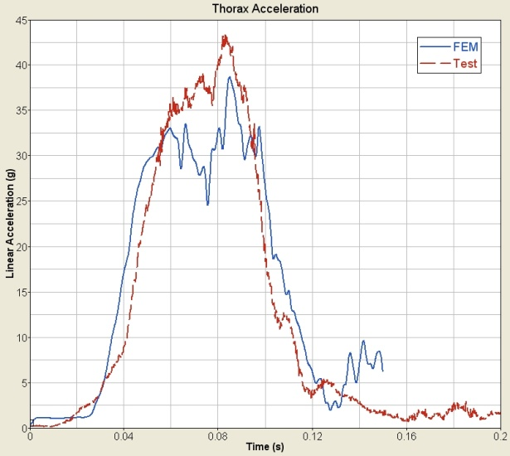
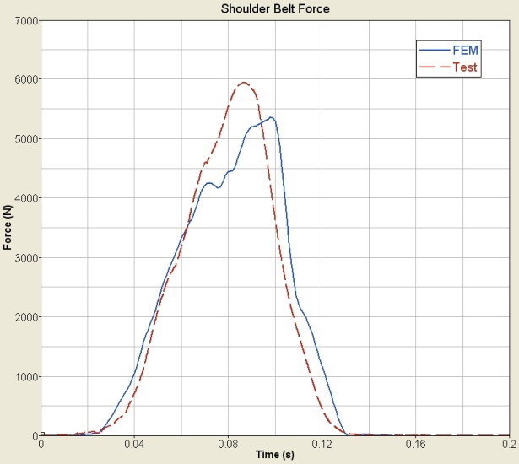
Comparison of Dummy Results
Head Acceleration
Chest Acceleration
Belt Force

Slide 18
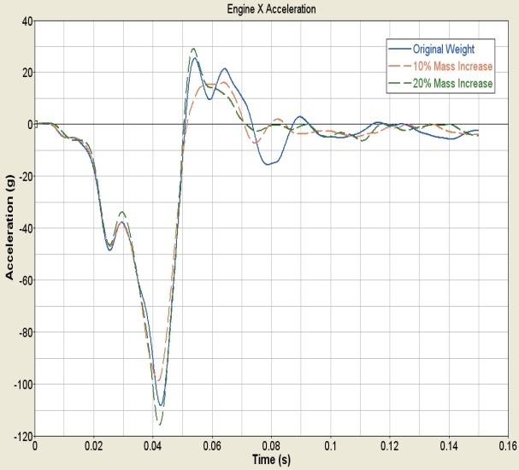
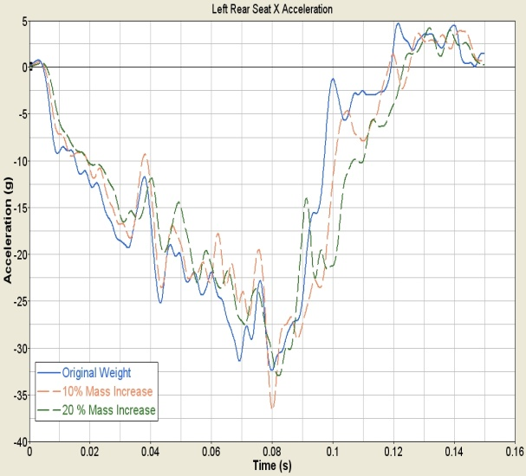
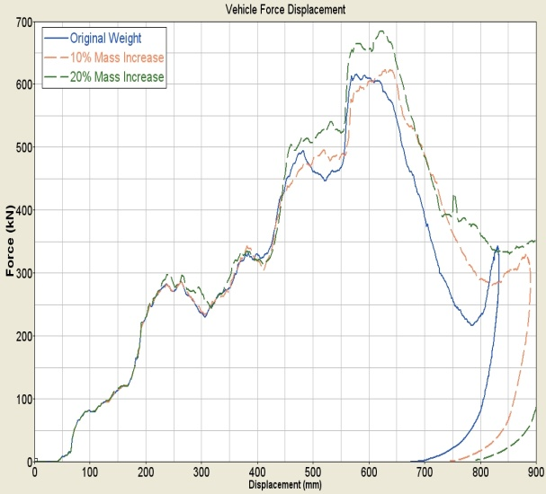
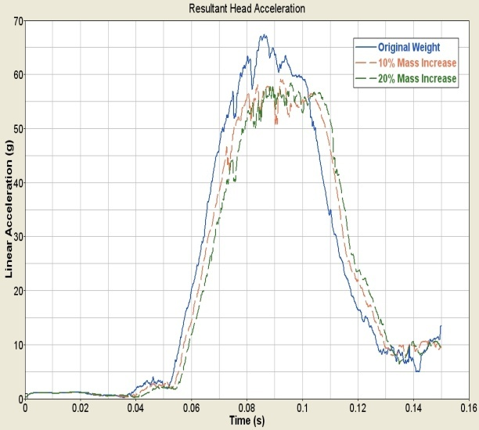
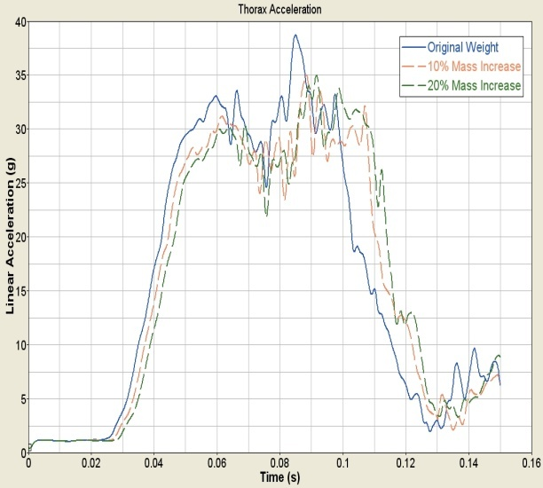
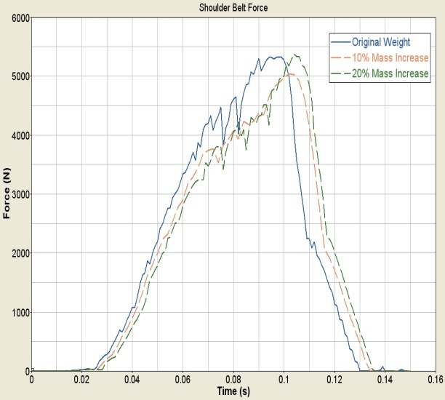
Effect of Increase in Mass

Slide 19
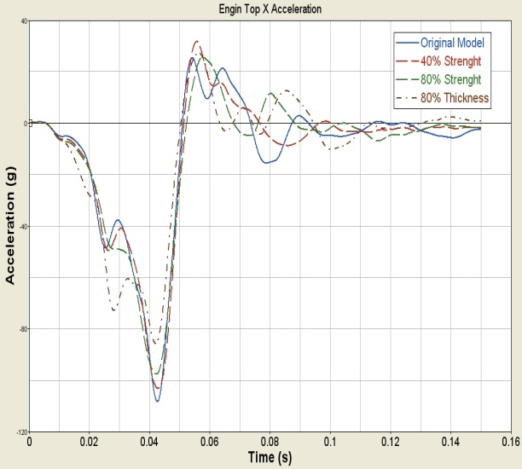
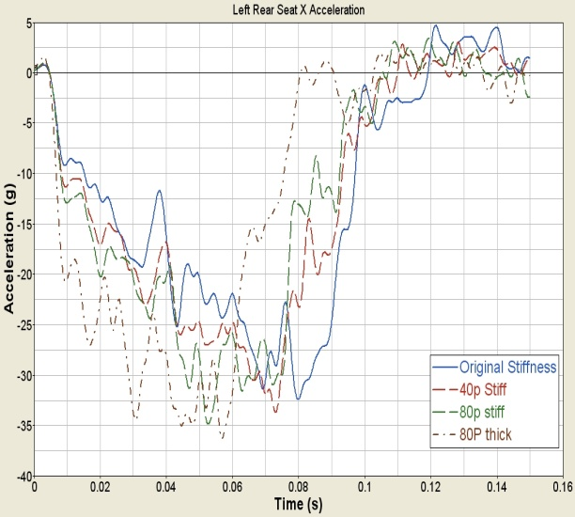
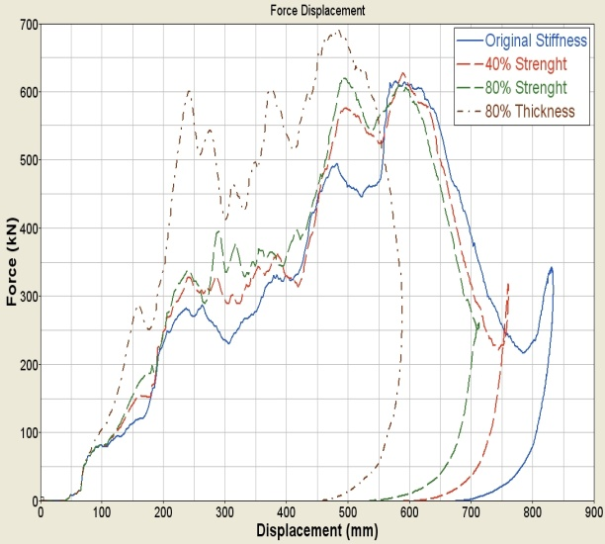
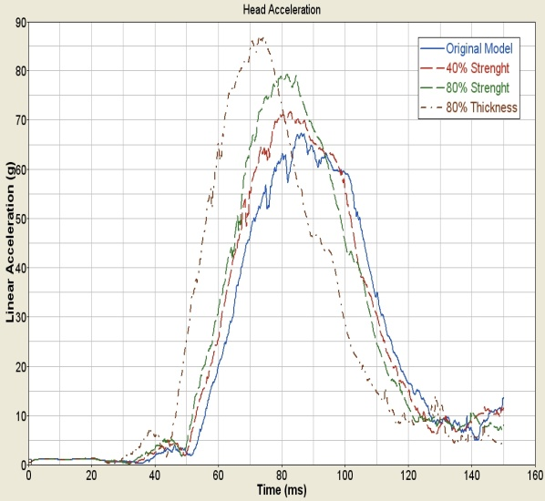
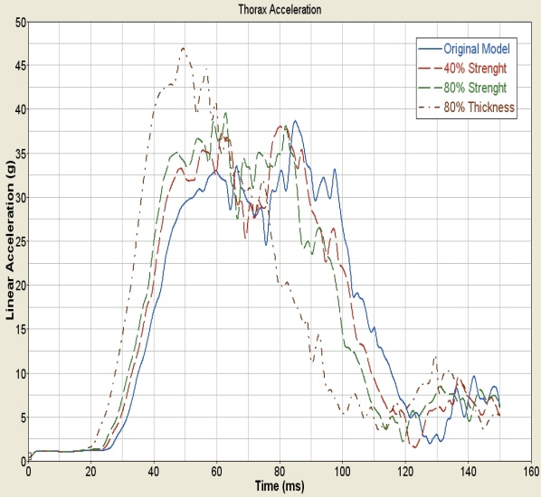
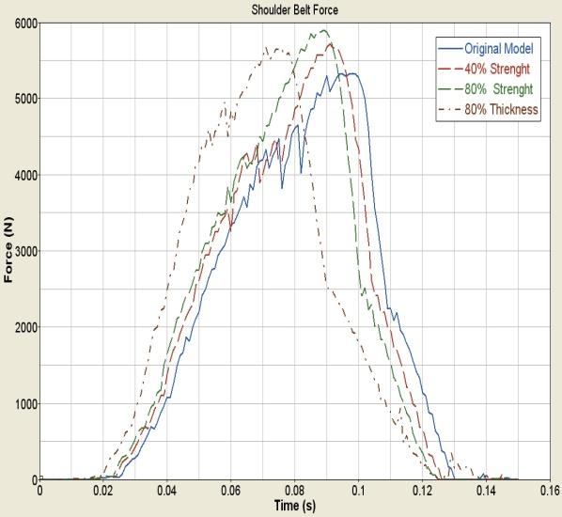
Effect of Increase in Strength and Thickness

Slide 20
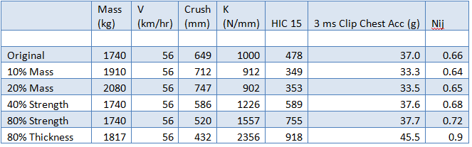
Matrix of Injury Parameters

Slide 21
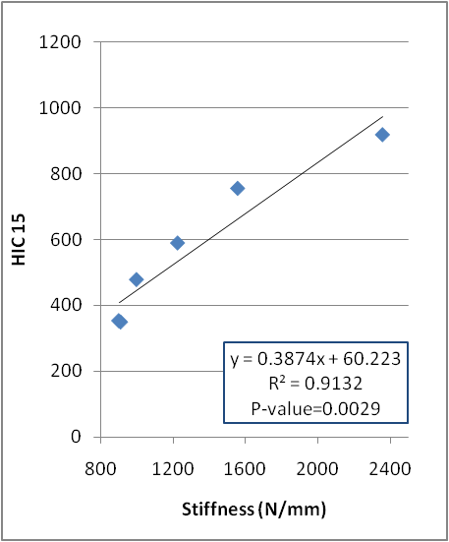
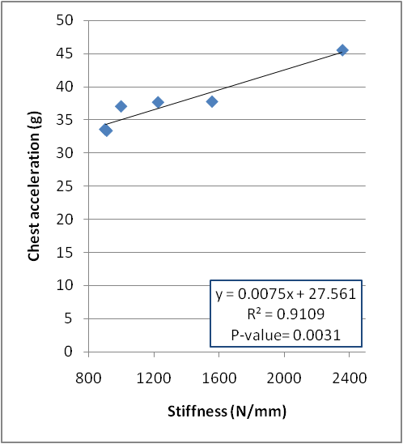
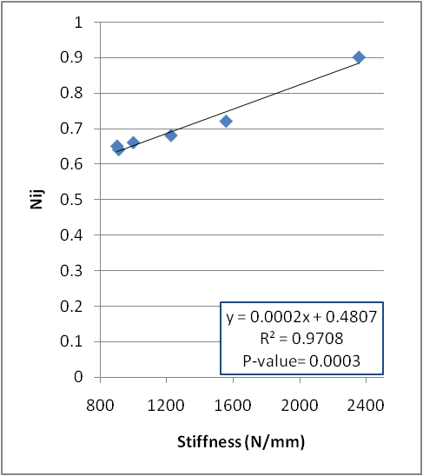
Results of Regression Analysis

Slide 22
Discussion-1
NCAP full-scale crash tests for 1187 vehicles during the 1982 to 2010 model years were investigated, to quantify changes in the average mass and stiffness of the vehicle fleet in United States.
The results showed that both the mass and stiffness of the vehicles have significantly increased during the past three decades. Previous studies confirm an increasing trend in frontal stiffness of the vehicles
The increase in stiffness could be a consequence of attempts to increase occupant compartment integrity and reduce intrusion. Stiffness may also increase when manufacturers want to reduce the size of front end of vehicle to reduce the weight and increase fuel efficiency.
The effect of changes in the stiffness of a vehicle on protection of rear seat occupants, who are not considered in either FMVSS 208 standard or NCAP and IIHS ratings, was studied using computer simulations.

Slide 23
Discussion-2
Finite element models of a mid-size vehicle and a 5% female dummy in the rear seat were used to evaluate the effect of these changes in vehicle structure (in mass or stiffness of the vehicle) on the protection of rear seat occupants.
Increase in stiffness of the vehicle, by using higher strength steel or thicker metal sheet, can significantly increase rear seat dummies’ head and chest accelerations and Nij.
Considering the significant increase in stiffness over model years of vehicles, this finding is aligned with findings of Menon et al, 2008 that showed higher acceleration and HIC values for rear seat dummies in newer model year NCAP tests.
  They used acceleration pulse of three model year groups of vehicles from 1980 to 2006 from NCAP test results and applied that to a 6 year old MADYMO dummy in a sled set up
These findings could also explain the real word accident data analysis results that protection of rear seat occupants has been reduced in newer model year vehicles both for children and for adults. Researchers have shown that the rear seat occupant injuries can be mitigated by using force limiting and petitioning belts for rear seat occupants

Slide 24
Limitation & Future Work
A limitation of this study is that only one dummy size and one vehicle type was investigated.
Also, the crash scenario and impact speed were limited to a 56 Km/hr full frontal rigid wall test.
Studying the effect of increase in stiffness in the protection of rear seat occupants in lower speed impacts, angle impacts, and for other dummy sizes would be a useful complement to this research.

Slide 25
Conclusion
This study was an effort to indentify the causes for reduced protection of rear seat occupants in recent model year vehicles as reported in previous publications.
An evaluation of full frontal crash tests, done by NHTSA, showed that the frontal stiffness of the vehicle fleet has significantly increased over model years of vehicles, from 1982 to 2010.
The safety features of airbags and advanced safety belt technology that is available in the front seat is generally not available in the rear seat. A finite element model of a Ford Taurus vehicle coupled with a 5% Hybrid III dummy model restrained with a 3-point belt in the rear seat of the vehicle was used to study the effect of changes in vehicle mass and stiffness on injury readings of the dummy.
The results showed that the increase in vehicle stiffness leads to increase in the HIC 15, 3 ms clip chest acceleration, and Nij of the dummy. Therefore, it is concluded that a prominent reason for reduced frontal protection of rear seat occupants in newer model year vehicles can be attributed to the increase in the stiffness of the vehicle fleet

Slide 26
Thank you for your kind attention!

