Slide 1


Reduced Protection for Belted Occupants in Rear Seats Relative to Front Seats of New Model Year Vehicles
Elham Sahraei, Kennerly Digges, Dhafer Marzougui
The National Crash Analysis Center, The George Washington University

Slide 2
Outline
Introduction
Methods
  FARS data and effectiveness estimates
  Vehicle crash tests
Results
Discussion
Conclusion

Slide 3
Introduction
Rear Seat Occupant Protection from Literature
Real world data studies report better protection for the occupants in the rear seats compared to those in the right front seats (Smith and Cummings 2004, 2006, Evans and Frick 1988, Berg et al. 2000, Arbogast et al. 2009)
Many crash tests have shown higher injury risks for the dummies in the rear seats when compared to those in the front seats (Kuppa et al. 2005, Tylko and Dalmotas 2005, Mizuno et al. 2007)
It is reported that the protective effect of the rear seat decreases with occupant age or by restraint system usage (Kuppa et al. 2005, Smith and Cummings 2006, Sahraei et al. 2009)

Slide 4
Introduction
New Findings on Rear Seat Occupant Protection
Sahraei and Digges (2009) used National Automotive Sampling System’s Crashworthiness Data System (NASS CDS) data to show that the risk of MAIS2+ injury for belted adult rear seat occupants has increased from 1.6% in model years (MY) 1993-1999 vehicles to 5.1% in MY 2000-2006 vehicles
In another study, using Fatality Analysis Reporting System (FARS) data, Sahraei et al. (2009) showed that the effectiveness of the rear seat relative to the right front seat has been decreasing significantly over model years of vehicles, both for belted and unbelted occupants

Slide 5
Method - FARS Data
FARS data of the years 1990-2008 were used for this study.
Model years of vehicles included were from 1990 to 2009.
The vehicles consisted of passenger cars, utility vehicles, minivans, and pickups with gross vehicle weights less than 10,000 lbs.
Frontal crashes with the principal direction of impact in the 11, 12, or 1 o’clock direction with no rollover were included.
occupants were divided into five age groups: 0-8 Years Old (YO), 9-15 YO, 16-24 YO, 25-49 YO, and 50+ YO. Vehicles were divided into two Model Year (MY) groups, 1990-1999 MY, and 2000-2009 MY.

Slide 6
Method - Effectiveness Estimates
For the effectiveness analysis, the double paired comparison method was employed (Evans 1986)
E= 100×(1-r₂/r₁)
  r₂ is the rear passenger to driver fatality ratio
  r₁ is the right front passenger to driver fatality ratio
  Estimates are considered statistically significant when both higher and lower error bounds are either positive or negative.

Slide 7
Methods - Vehicle Crash Tests 1
Tests available from the NHTSA vehicle database with an adult 5%ile female or 50%ile male dummy restrained with a 3-point belt in the rear seat were investigated (46 tests)
The dummies in the front seats of these tests were 5%ile female, 50%ile or 95% male dummies
Two of the dummies included were THOR dummies, 20 of them were Hybrid III with THOR legs, and the rest were Hybrid III dummies

Slide 8
Methods - Vehicle Crash Tests 2
The tests were vehicle-to-barrier tests with a “00” impact angle (12 o’clock direction) with a 3 to 5 star NCAP rating
The crash speeds for these tests were 40-57 km/h. Tests were divided to three groups based on the test speed: 40, 48, and 56 Km/h.
As only belted dummies in the rear seat were included. Driver and Front passenger airbags were deployed in all tests
Vehicle model years included were 2002-2006. Body types of these vehicles were passenger cars, utility vehicles, minivans, and pickups

Slide 9
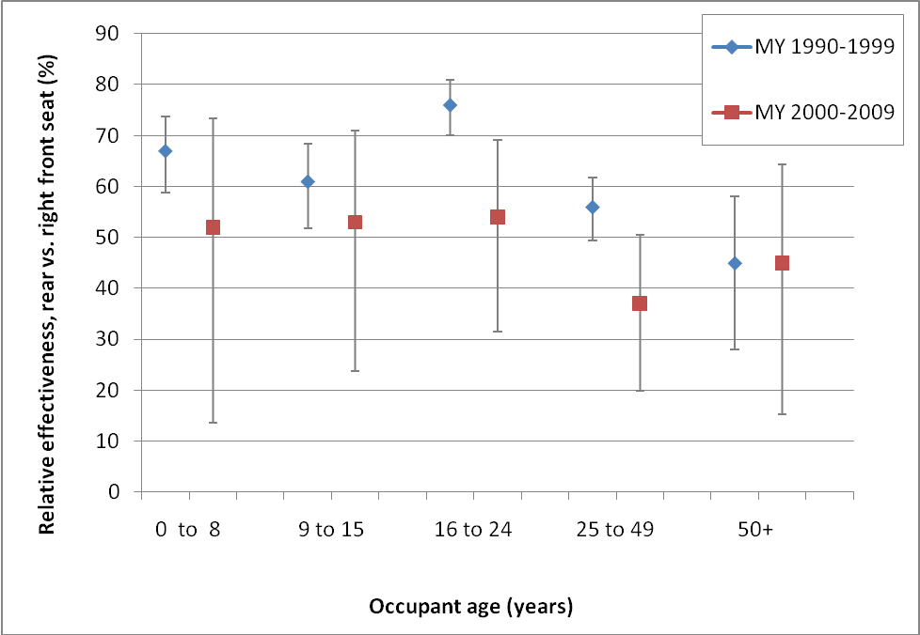
Results - Unbelted Occupants
Effectiveness of rear seat compared to right front seat in protecting unbelted occupants

Slide 10
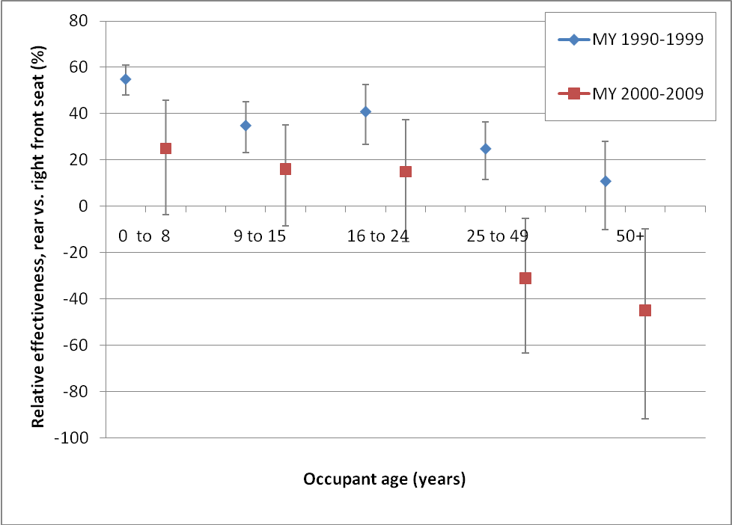
Results - Belted Occupants
Effectiveness of rear seat compared to right front seat in protecting belted occupants

Slide 11
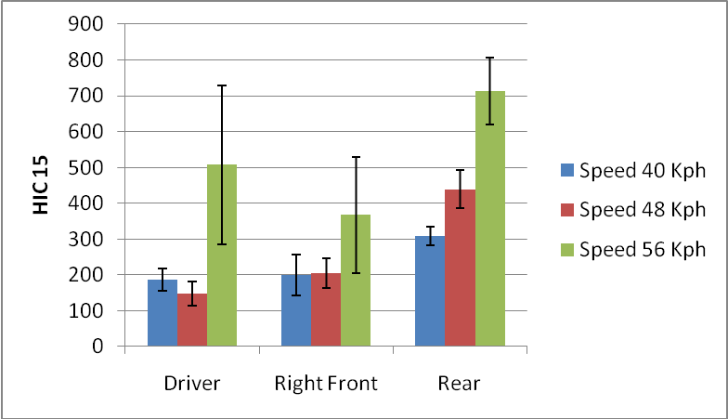
Crash Test Data Results – Head Injury Criteria
The HIC15 for the rear seat dummies is more than twice of that for the driver at 48 Km/hr tests (p-value <0.0001). HIC15 was also significantly higher for rear seat dummies compared to right front seat dummies at 56 Km/hr (p-value=0.012) and higher for rear seat compared to right front and driver dummies at 40 Km/hr (p-value=0.0001).

Slide 12
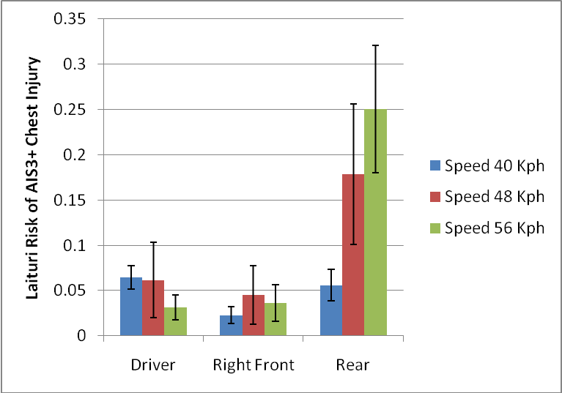
Results - Laituri risk of AIS3+ thorax injury
The Laituri risk is higher for the rear seat dummies compared to the driver and right front seat dummies at speeds of 48 and 56 Km/hr (p-values= 0.014 and 0.0021); however, the difference is not significant at speed of 40 Km/hr (p-value= 0.10)

Slide 13
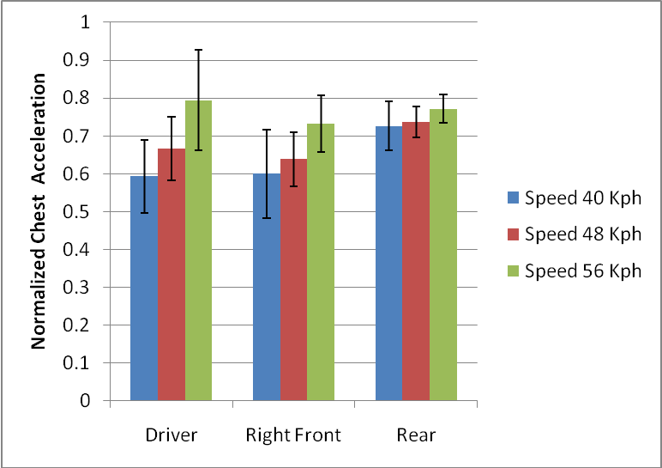
Results - Normalized Chest Acceleration
The difference between chest accelerations is not significant at any of the speeds (p-values= 0.087, 0.12, and 0.62 at 40, 48, and 56 km/hr respectively)

Slide 14
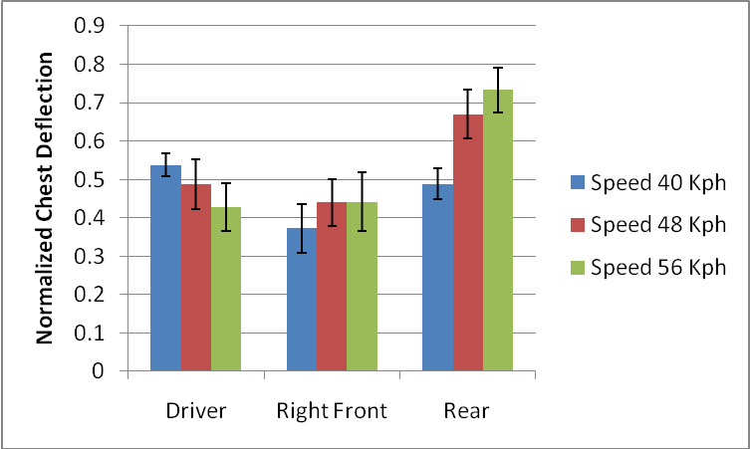
Results - Normalized chest deflection
Normalized chest deflection is higher for rear seat occupants when compared to right front seat occupants (p-value= 0.0078) at 40 Km/hr. Also, it is higher for rear seat occupants compared to both right front seat occupants and drivers at speeds of 48 and 56 Km/hr (p-values <0.0001).

Slide 15
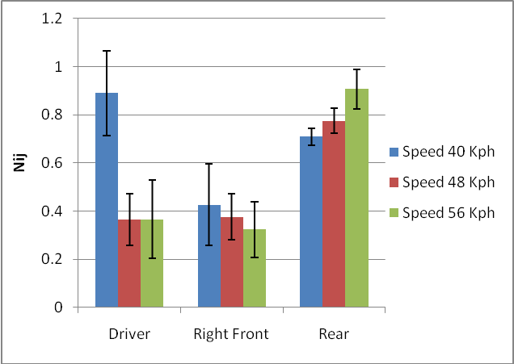
Results – Neck Injury Criteria
N_{ij} values are also higher for dummies in the rear seat compared to those in right front seat at all three speeds (p-values <0.0001). They are also higher for rear dummies compared to driver (p-values <0.0001) at speeds of 48 and 56 Km/hr

Slide 16
Summery and Discussion 1
Results showed that the relative effectiveness has decreased in newer model years of vehicles (2000+ MYs) compared to the older MY group
While belted occupants of all age groups were better protected in rear seats rather than right front seats of older model year vehicles, none of the age groups of belted occupants are significantly better protected in rear seats of newer model year vehicles

Slide 17
Summery and Discussion 2
The most important finding was the “negative” effectiveness for all belted adult occupants of 25+ years old in newer model years of vehicles
This finding was also corroborated by the available crash test data which showed higher injury measures for the dummies in the rear seats compared to those in the right front or driver seats
Unbelted occupants; however, are still better protected in rear seats compared to the right front seats, even in the newer model year vehicles

Slide 18
Summery and Discussion 3
These findings of reduced relative effectiveness for most age groups of occupants confirm previous reports by Sahraei et al. (2009) regarding the decreasing trend of relative (rear/front) effectiveness over model years of vehicles
It is also consistent with previous reports that the risk of MAIS2+ injury for rear seat adult passengers (not relative to front seat occupants) has increased in newer model years of vehicles (Sahraei and Digges 2009, Sahraei et al. 2009)

Slide 19
Limitation
Limitations of this study include that the crash test data were not a statistical sample of crash responses of the vehicle fleet on the road. Therefore, the results cannot be expanded to the entire vehicle fleet. Also, no causes or countermeasures have been investigated in this research.

Slide 20
Conclusions
The newer model year had lower relative effectiveness for several age groups of occupants
For belted occupants, a significantly better protection in the rear seat was not found for any age groups of occupants in the newer model year vehicles (2000+ MY)
In fact, belted occupants of 25+ years old are significantly less protected in rear seats compared to right front seats of 2000+ MY vehicles
Unbelted occupants are still significantly better protected in the rear seats as compared to the right front seats, even in the newer model year group

Slide 21
Thank you for your kind attention

