Slide 1


Protection of Rear Seat Occupants in Frontal Crashes, Controlling for Occupant and Crash Characteristics
Elham Sahraei
Damoon Soudbakhsh
Kennerly Digges

Slide 2
Outline
Introduction and background
Method:
  Double paired comparison method
  Logistic regression
Results:
  Rear seat occupant protection for different age groups
  Trend of rear seat protection over MYs of vehicles
Discussion
Conclusion

Slide 3
Introduction
Rear seat occupants (Viano and Parenteau 2008)
  About 12% of occupants in tow-away crashes
  About 10% of all the fatalities reported in FARS
As rear seat occupancy has increased over the years, the probability of having rear seat occupants in tow-away or fatal crashes has increased as well (Parenteau and Viano 2003)
The need for a better understanding of rear seat injuries and of the factors that affect the probability of injury

Slide 4
Background, Accident Data
By investigating accident data, researchers have found an overall safety benefit to occupants in the rear seat position compared to those in the right front seat
  Evans and Frick (1988) reported a 26% lower risk of injury for rear seat / front seat counterparts
  Smith and Cummings (2004) using NASS CDS data, estimated a 39% lower risk of death for rear /front seat occupants
  Using FARS data (Smith and Cummings 2006) a 21% lower risk of death on average for rear/RF seat occupants
  Kuppa et al. (2005) using FARS, most age groups benefited from sitting in the rear seat

Slide 5
Background, Newer Findings
Kuppa et al. (2005) and Kent et al. (2007) reported that restrained occupants older than 50 years of age would not benefit from sitting in the rear seat
Recent crash tests: higher injury measures (HIC, chest acceleration, etc.) for dummies in the rear seat /front seat (Kuppa et al. 2005, Tylko and Dalmotas 2005, Mizuno et al. 2007, Hong et al. 2008)
Discrepancy between the real world accident data analyses, and the NCAP crash tests results

Slide 6
Background, Trend of changes
Sahraei and Digges (2009), NASS CDS, risk of injury
  Adult rear seat occupants, better protected in older MY vehicles (1993-1999), not in newer MY vehicles (2000-2006)
  Increase in Risk of Injury for rear seat occupants
  Risk of AIS2+ head injuries have significantly increased in the newer model years of vehicles
  Method did not include a control for severity of the crashes being compared

Slide 7
Method
To control the characteristics of the crash
Double paired comparison (FARS data)
  Compares the risk of injury to the occupants with a control group in the same vehicle
Binary logistic regression (NASS CDS)
  Influence of crash severity, gender, belt use, and occupant age on changes in protection of rear seat occupants over model years of vehicles

Slide 8
Method, FARS Data
FARS data files years 1991-2007
  Passenger cars, utility vehicles, minivans, and pickups with gross vehicle weight less than 10,000 lbs
  Model Years later than 1991
  Only frontal crashes (11, 12, or 1 o’clock), no rollover
  The two child age groups : 0 – 8 YO, 9 – 15 YO
  Two adult age groups: 16 - 49 YO, 50+ YO
  5 MY groups: 1991-1993, 1994-1996, 1997-1999, 2000-2002, and 2003-2008

Slide 9




Method, Effectiveness Analysis
The double paired comparison (Evans, 1986)
  Group A: crashes with a driver and a right front passenger, at least one of them killed
  Group B: crashes with a driver and a rear seat passenger, at least one of them killed
r= passenger to driver fatality ratio

Slide 10
Method, Control Group Selection
If there is a bias in the age of control groups, the crash severity is not properly controlled by the control group
  Driver injury tolerance decreases with age (Evans 2001 and Zhou et al. 1996)
  Driver age also affects driving speed (Kent et al. 2005 and Augenstein et al. 2007)
Two control groups were investigated
  1st: Cases with drivers of all ages above 16 (unfiltered)
  2nd: Cases with drivers of ages 25-45 (filtered )

Slide 11


Method, NASS CDS data
NASS CDS data of the years 1993 to 2007
MYs 1993-2008 in frontal crashes with no rollover
  Principal direction of force in the 11, 12, or 1 o’clock
  General Area of Damage, GAD in the front
Passenger cars, utility vehicles, minivans, and pickup trucks
The NASS weighting factors used, > 1500 excluded
The SURVEYLOGISTIC, probability of MAIS2+

Slide 12
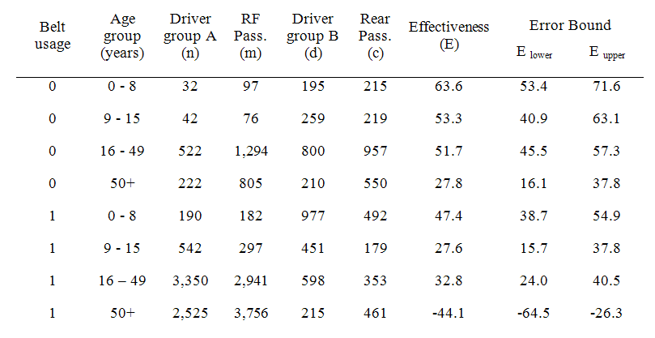
Results, Effectiveness by Age Group
(Unfiltered Calculations)

Slide 13
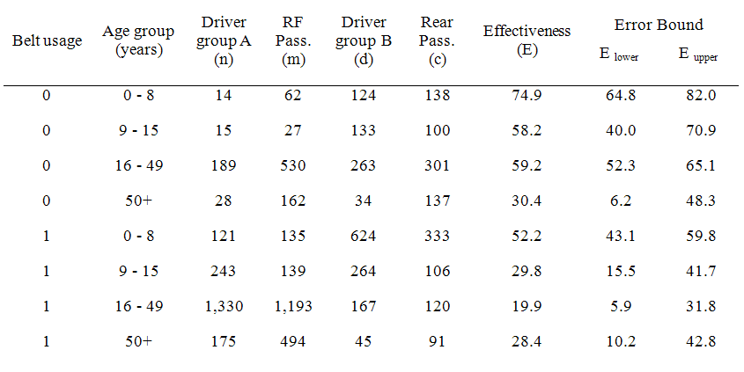
Results, Effectiveness by Age Group
(Filtered Calculations)

Slide 14
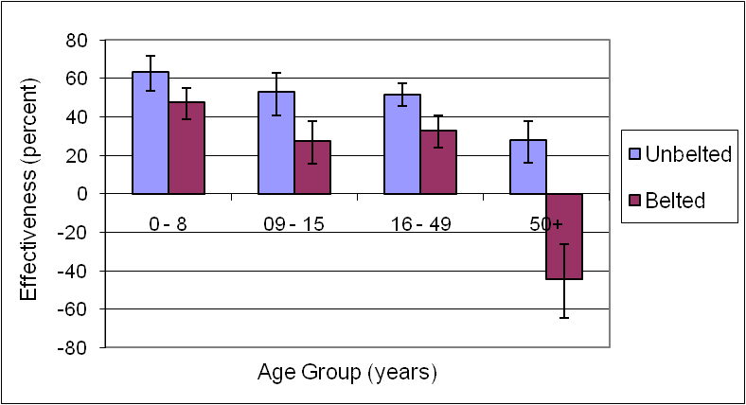
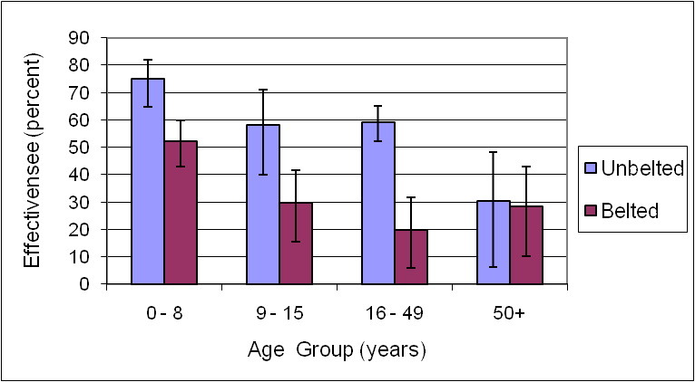
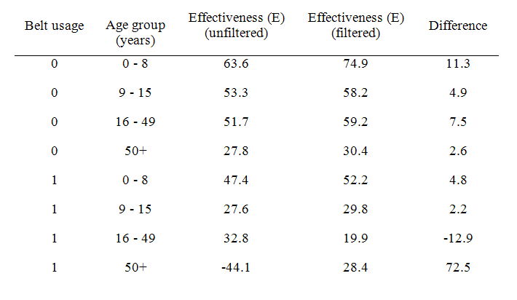
Results, Effectiveness by Age Group
(Unfiltered vs Filtered Calculations)

Slide 15
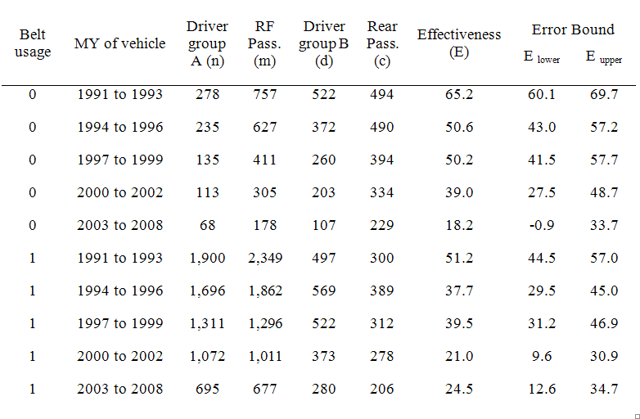
Results, Effectiveness by MY Group
(Unfiltered Calculations)

Slide 16
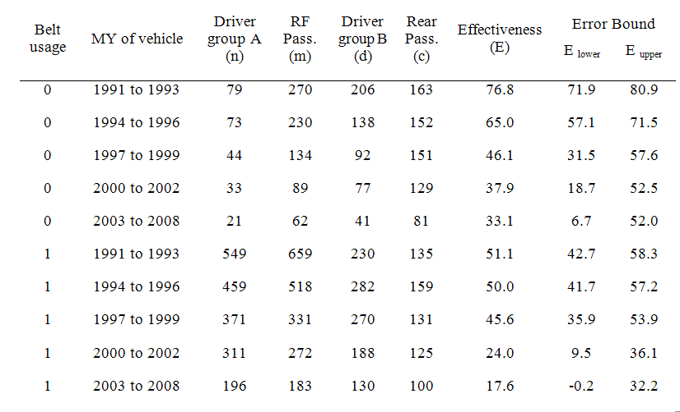
Results, Effectiveness by MY Group
(Filtered Calculations)

Slide 17
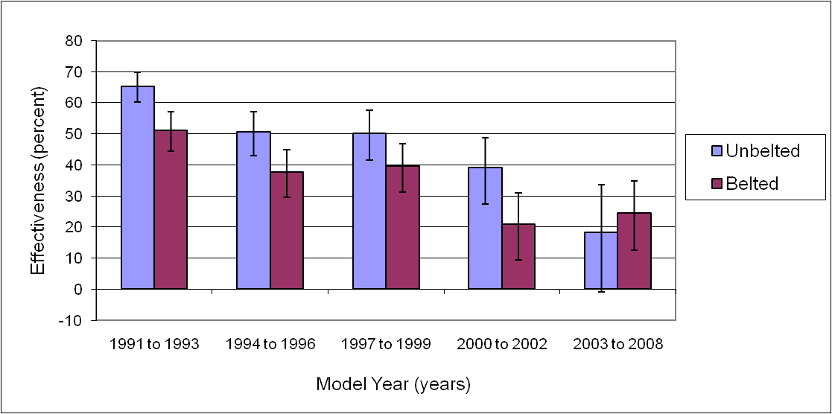
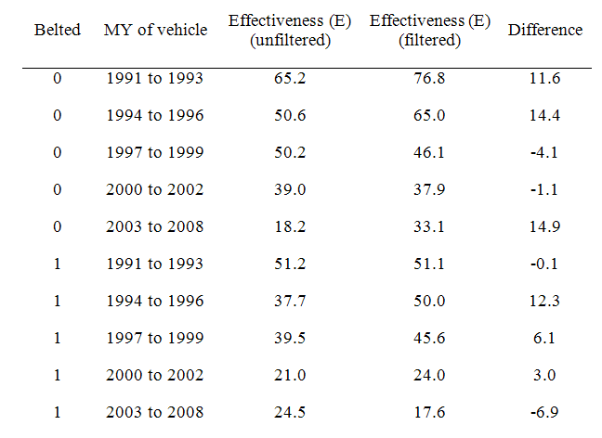
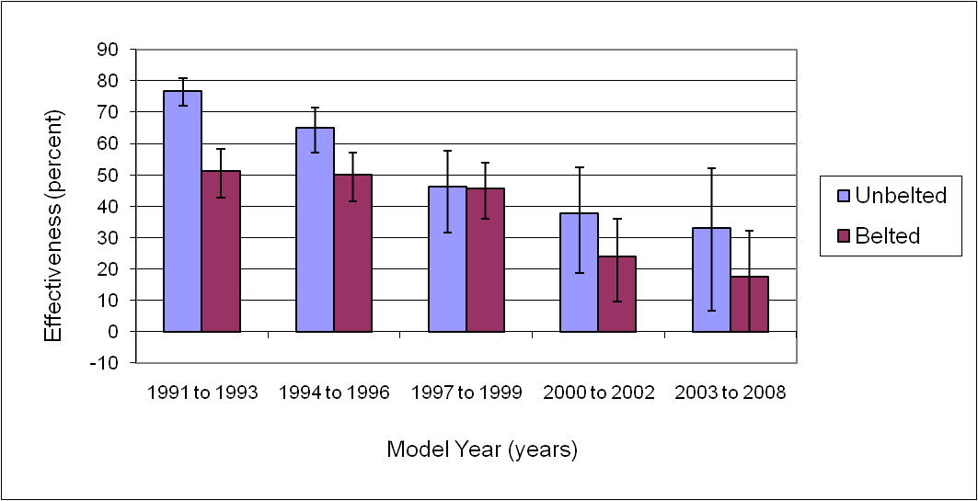
Results, Effectiveness by MY Group
(Unfiltered vs Filtered Calculations)

Slide 18
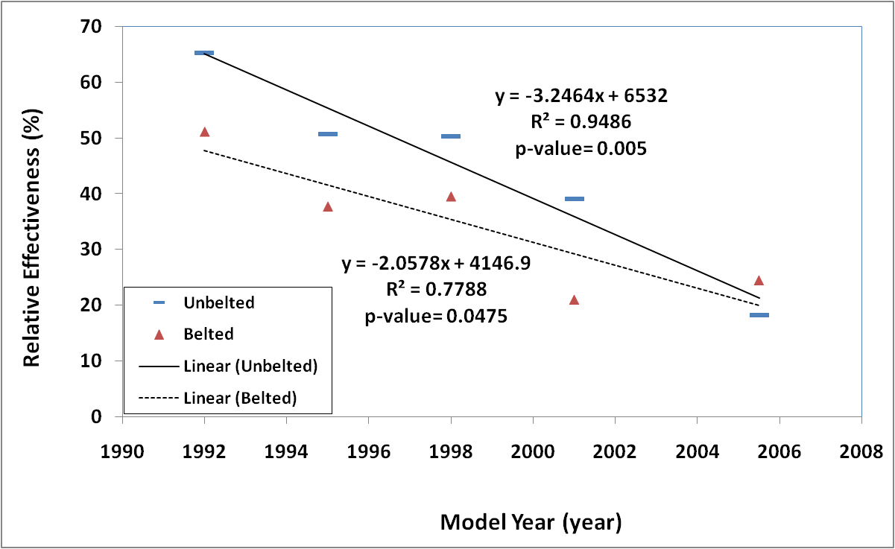
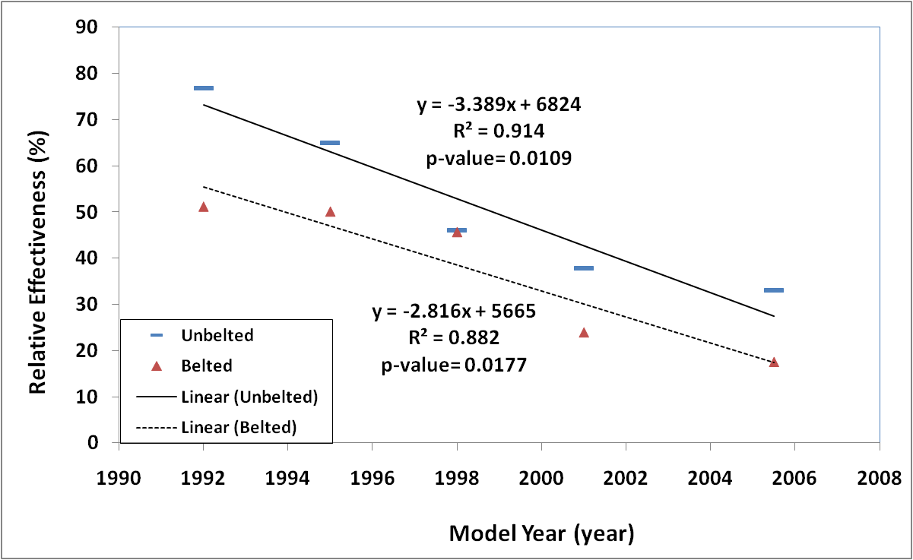
Results, Trend over MYs
(Unfiltered/ Filtered Calculations)

Slide 19
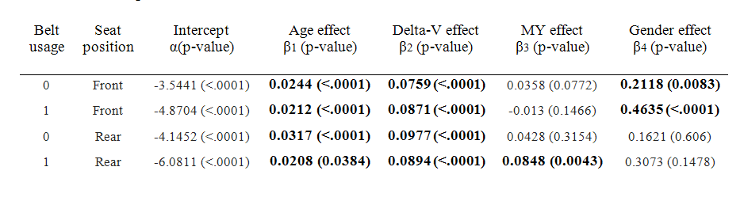

Results, Logistic Regression (1)
Occupants of all ages are included

Slide 20
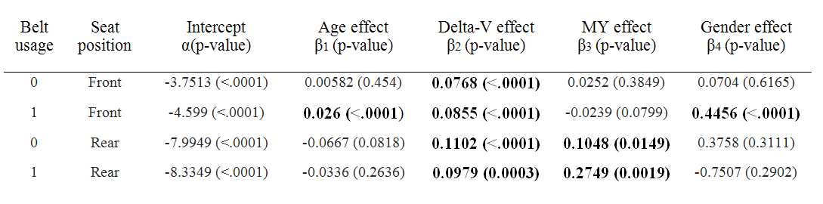
Results, Logistic Regression (2)
Adult occupants of ages 16-50 are included

Slide 21
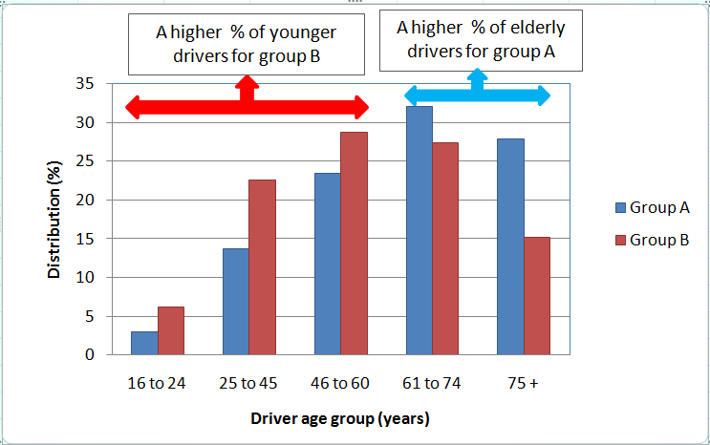
Discussion, Filtered vs. Unfiltered
Relative effectiveness for 51+ YO: -44.1% or 28.4%?
Unfiltered calculations: younger drivers in group B vs. A
  Passengers in group B in higher severity crashes
  Passengers in group B were compared to resilient drivers
  Passenger/driver fatality ratio unrealistically high for Group B
r= passenger to driver fatality ratio

Slide 22
Discussion, Trend over MYs
Reduction in relative effectiveness over MYs of vehicles
  Due to emergence of advanced safety systems for front seat occupants in newer model years
  Result of an increase in injury risk to the rear seat occupants due to the increasing frontal stiffness of vehicles in newer MYs
  The stiffer the vehicle, the stronger the crash pulse transmitted to the rear seat compartment, where the occupant protection technology has not kept up with the front seat technology
Logistic regression results : the latter is contributing more

Slide 23
Comparison with literature
On average, rear seat occupants are better protected than right front seat occupants are consistent with Evans and Frick (1988) and Smith and Cummings (2004 and 2006)
Our effectiveness calculations for occupants < 50 years old are corroborated by Kuppa et al. (2005)
Our findings of reduced protection effectiveness over MYs of vehicles are consistent by Kent et al. (2007)
Results of the logistic regression analysis are corroborated by findings of Sahraei and Digges (2009)
Our results are also in accordance with the findings of the crash tests (Kuppa et al. 2005, Tylko and Dalmotas 2005, Mizuno et al. 2007, Hong et al. 2008)

Slide 24
Limitations
Assumption that the FARS and NASS variables (belt usage, weighting factors, etc.) used in the study did not have any biased errors
In case of multiple impacts, possible that some injuries were produced through a second most harmful event other than a rollover, assumed those are not biased toward one seating location
Ideally, this study would be performed with crashes in which the rear seat occupant and right front seat occupant were in the same vehicle, bus as cases are limited and not from similar age double paired comparison used

Slide 25
Summery and Conclusions (1)
The double paired comparison method was used
Two methods of control group selection were employed: an unfiltered (cases with drivers ages 16+), and a filtered (cases with drivers 25-45 YO)
When there was a considerable difference between age groups of drivers in groups A and B, filtration changed the results substantially

Slide 26
Summery and Conclusions (2)
The maximum difference filtered /unfiltered was 72.5%, for belted passengers 50+ YO(E unfiltered = -44.1 E filtered = 28.4%)
Considering the vast difference in the ages of drivers in groups A and B, filtered calculations are believed to be a better estimate
For all other age groups, the differences were less than 13%, and indicated better protection for the occupants in the rear seat
This protective effect is max. for unbelted children younger than 8 YO (E = 74.9% (filtered) or 63.6% (unfiltered)), and decreases for adult occupants
Unbelted occupants benefit more from sitting in the rear seat than belted occupants

Slide 27
Summery and Conclusions (3)
Effectiveness of the rear seat relative to the front seat has been reduced for newer model year vehicles
  For belted occupants, from 51.1% to 17.6% from MYs 1991-1993 to MYs 2003-2008
  For unbelted occupants, from 76.8% to 33.1%
Regression analysis on NASS CDS data showed that the model year has a significant effect on increasing probability of MAIS2+ injuries in frontal crashes
  For rear belted occupants (p-value = 0.0043)
  For the rear occupants of 16-50 YO, model year was a significant factor for both belted (p-value = 0.0019) and unbelted (p-value = 0.0149) groups

Slide 28
Summery and Conclusions (4)
Considering the recent trend of increasing occupancy rates in the rear seat positions, the reduction in the rear seat occupant protection may result in an undesired increase in frontal crash fatalities, if it continues without mitigation in the future model years
Further attention by the industry and government agencies would help to ensure adequate protection is provided for occupants seated in the rear rows of vehicles, particularly with the development of newer model year vehicles

Slide 29
Acknowledgement
The authors would like to express their thanks to Mr. Richard Morgan, Ms. Lilly Nix, and Ms. Jenny Sullivan for their editorial assistance

Slide 30
Thank you for your kind attention

